Slide 1

eGovSchemes
Students Name:
Aditi Kesarkar (210339616005)
Dhruv Kesarkar (210339616028)
Dhruv Kolhe (210339616030)
Mentor Name:
Prof. Ashish Pandey
Prof. Dhwani Jagani

Slide 2
Outlines
Abstract
Introduction
Advantages
Disadvantages
Diagrams (E-R , Use case , System flow)
Existing System
Proposed System
Tools & Technology
Implementation
Code

Slide 3
Abstract
Government schemes are used in various sectors to address specific challenges, promote development, and improve the well-being of citizens. This abstract presents an overview of about why government plans for different areas are important, what they aim to do, and how they affect things by focusing on areas such as education, healthcare, infrastructure, and social welfare. This project connects different government schemes together in one place. This helps different parts of the government work together, makes things more clear and open, and helps people make better choices.

Slide 4
Introduction
The “eGovSchemes” is an exciting project that brings different government plans together on the internet. This special platform is like a main place where regular people, government leaders, and others can find lots of details about many government ideas. When these plans are connected in one project like this, it helps different parts of the government work together, makes information clear, and helps everyone make better choices. These platform offers a user-friendly interface that enables users to explore government schemes spanning education, healthcare, agriculture, infrastructure, social welfare, technology, and more. Through detailed profiles for each scheme, users can delve into their objectives, eligibility criteria, benefits, and application procedures.

Slide 5

Some of the Government Schemes

Slide 6
Advantages
Saves time and money by doing things online.
Helps people learn about government stuff.
Makes it easy to see if government plans are working.
One place for all the schemes makes it easy to find info.
Updates happen fast on the website.
Lots of info about each scheme helps people understand them better.
Applying online means less filling out forms by hand.
Citizens get quicker responses to their applications

Slide 7
Disadvantages
No internet means some people can't use the website.
Too much information can confuse users.
Big websites need a lot of resources to manage.
Technical issues can make the website hard to use.
Complicated plans can be misunderstood by users.
Some people might not understand the language used on the websites.
Not everyone can get assistance if they need help using the websites.

Slide 8
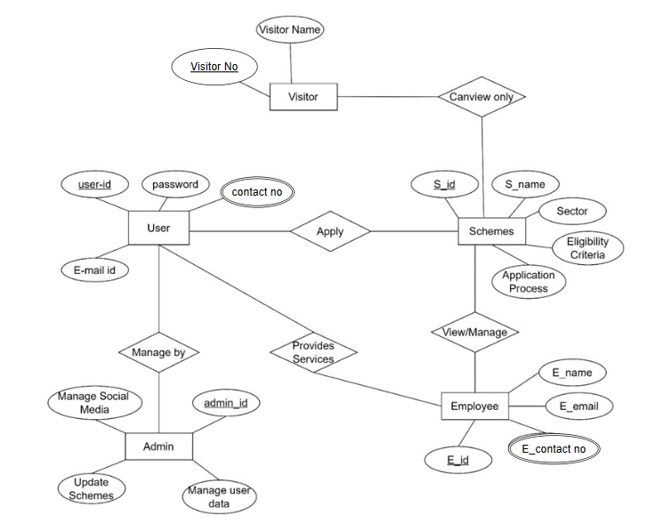
E-R Diagram

Slide 9
USE CASE DIAGRAM

Slide 10
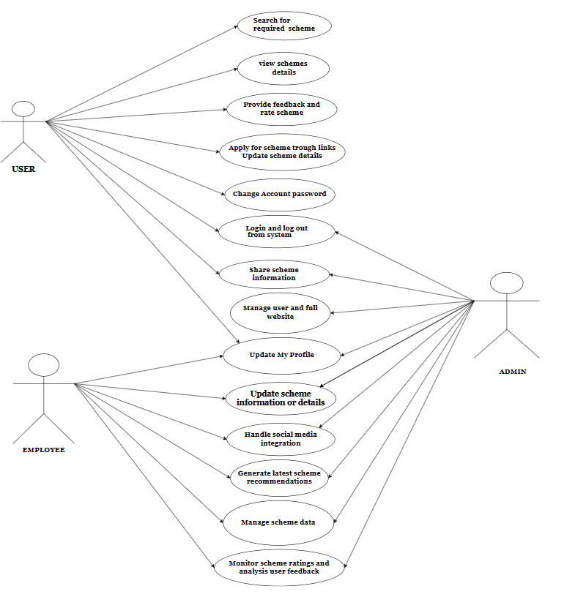

Slide 11
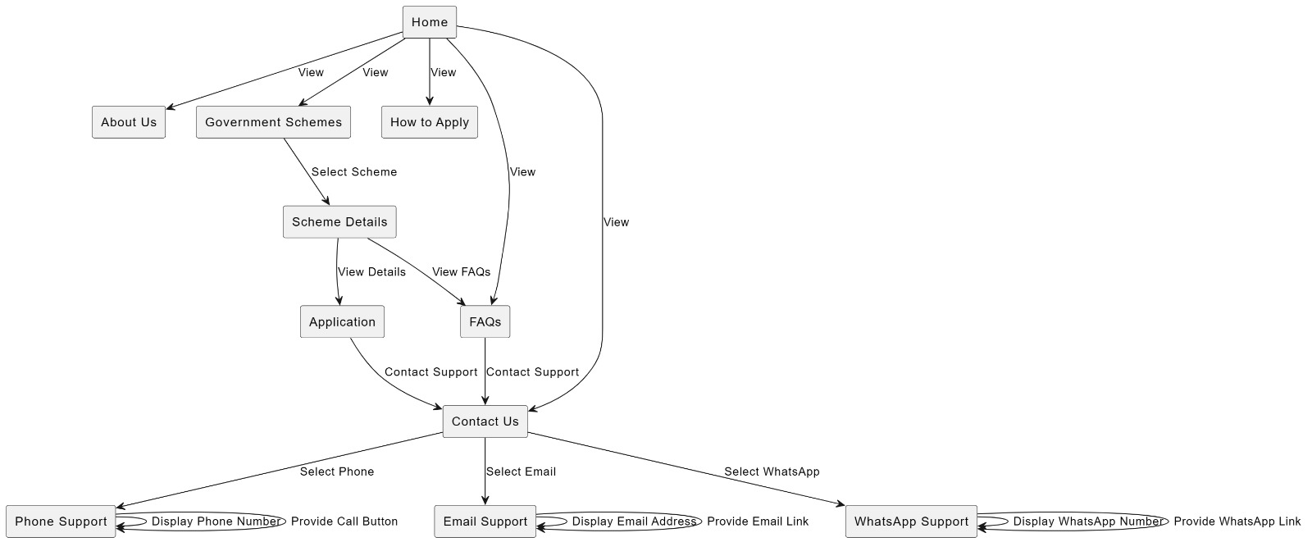
System flow diagram

Slide 12
Existing System
The current system for accessing e-government schemes, represented by platforms like JanSamarth ,MyScheme , and the National Portal of India, faces significant challenges. These platforms operate independently, making it hard for citizens to find complete and updated information about available schemes. Navigating multiple websites leads to confusion and duplicate efforts, as individuals fill out repetitive forms and gather information from various sources. This decentralized setup also hampers policymakers' ability to evaluate scheme effectiveness and identify areas for improvement. Simplifying access to e-government schemes is essential for enhancing citizen engagement and streamlining administrative processes.

Slide 13
Proposed System
The proposed system wants to fix the problems that the existing system has by creating a unified and user-friendly platform that's easy for everyone to use and has all the government schemes in one place. Here's an outline of the proposed system:
Sort schemes into categories like education, healthcare, etc., so people can find what they want easily.
Use pictures and links to show how schemes are connected.
Make one website for all government schemes.
Give clear info about each scheme, like what it's for and who can use it.
Integrate a “Contact Us" for direct user assistance by trained employees, ensuring prompt support and improving user experience.

Slide 14
Tools & Technology
Technology-
HTML: Structure for web content.
CSS: Styling for web content.
JavaScript: Interactivity and behavior.
MySQL: Data storage and retrieval.
PHP: Connection with webpage for user login.
Tools-
Visual Studio Code (VS Code): Code editing and development.
XAMPP server: For using MySQL

Slide 15
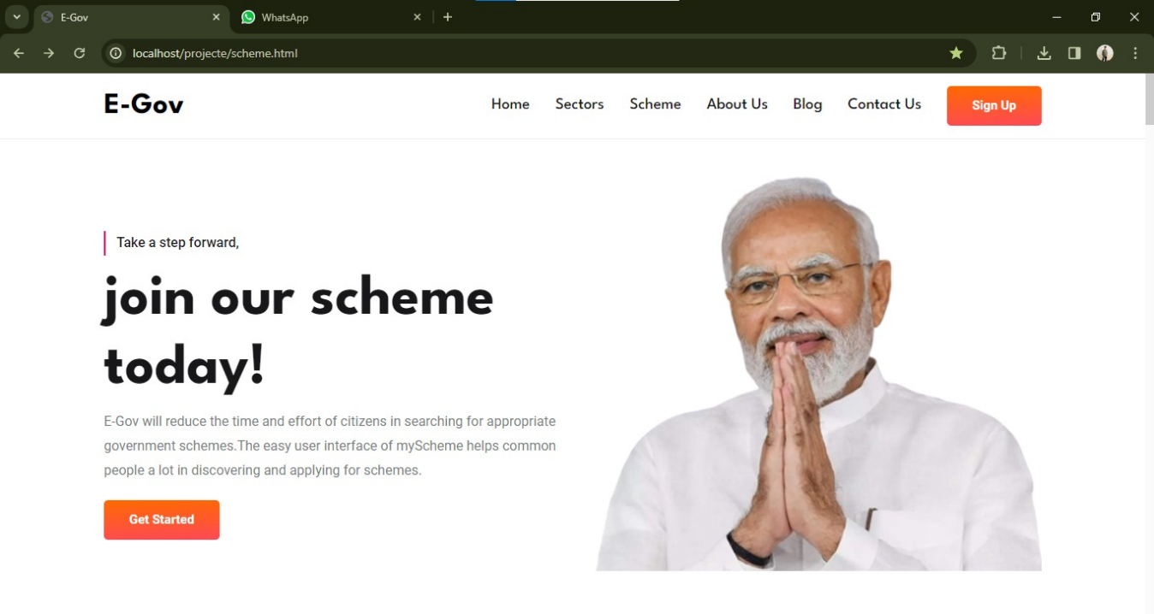
Implementation
Figure 1.1 Home page

Slide 16
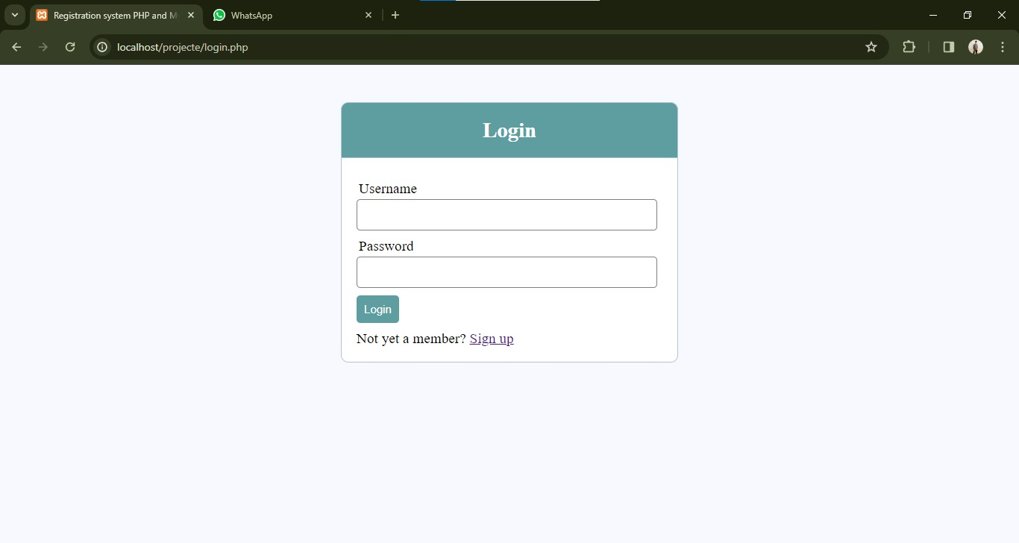
Figure 1.2 Login page

Slide 17
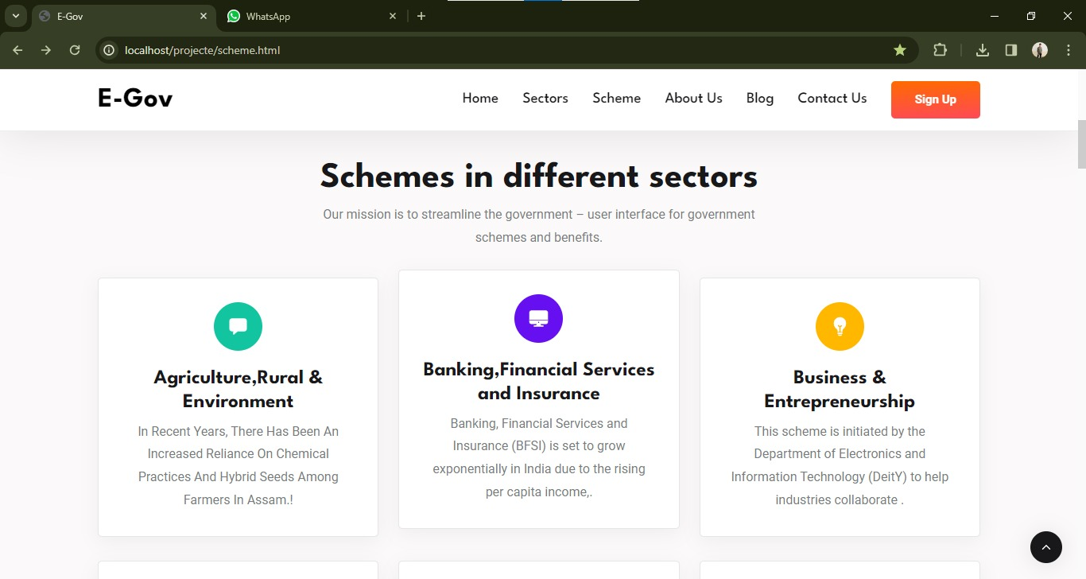
Figure 1.3 Schemes

Slide 18
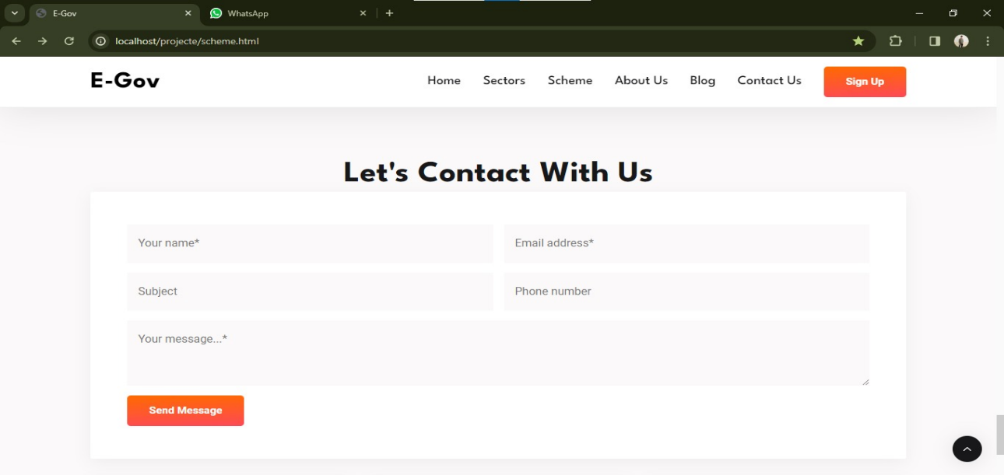
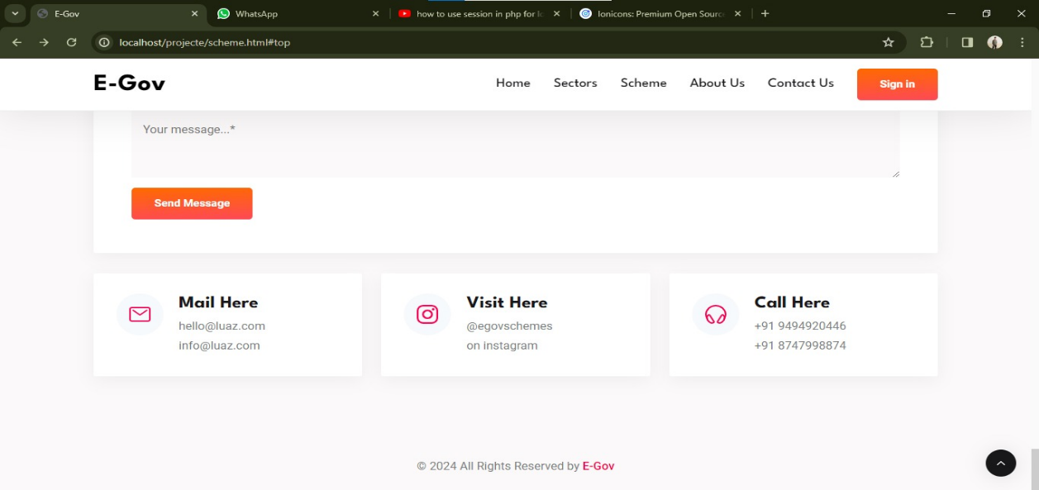
Figure 1.4 Contact Us

Slide 19
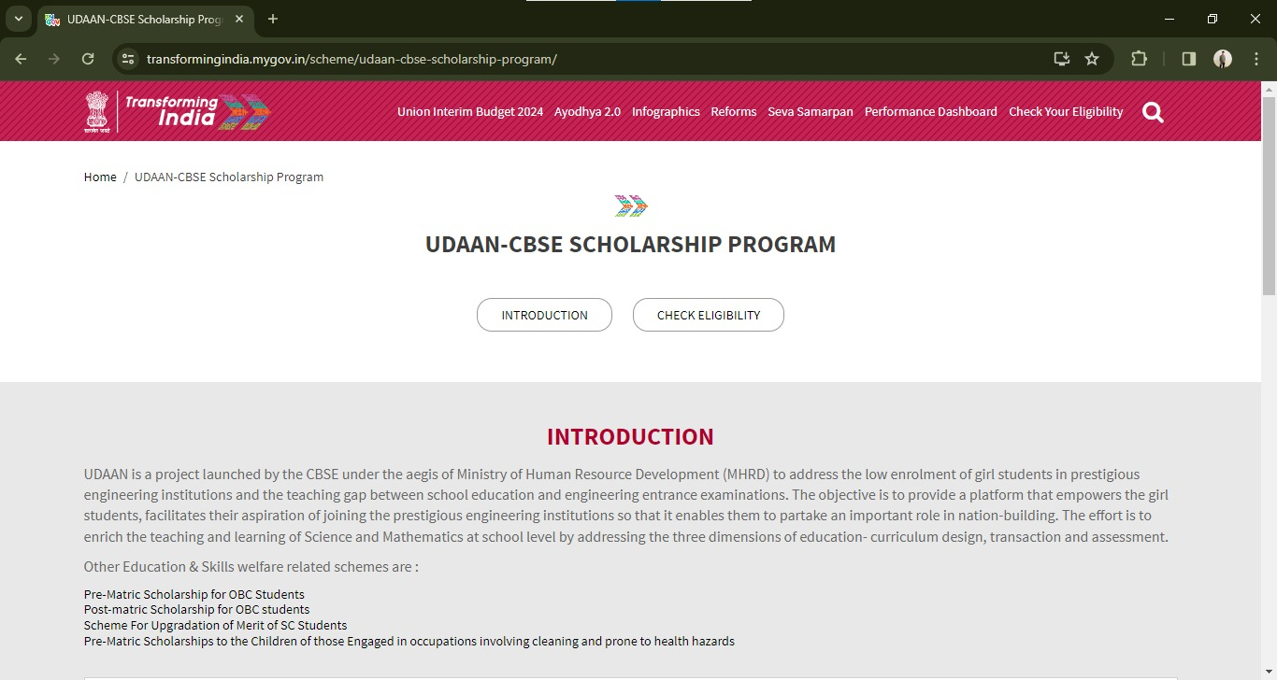
Figure 1.5 Application page

Slide 20
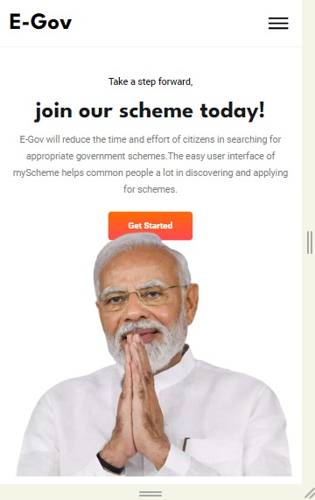
Figure 1.6 Mobile interface

Slide 21
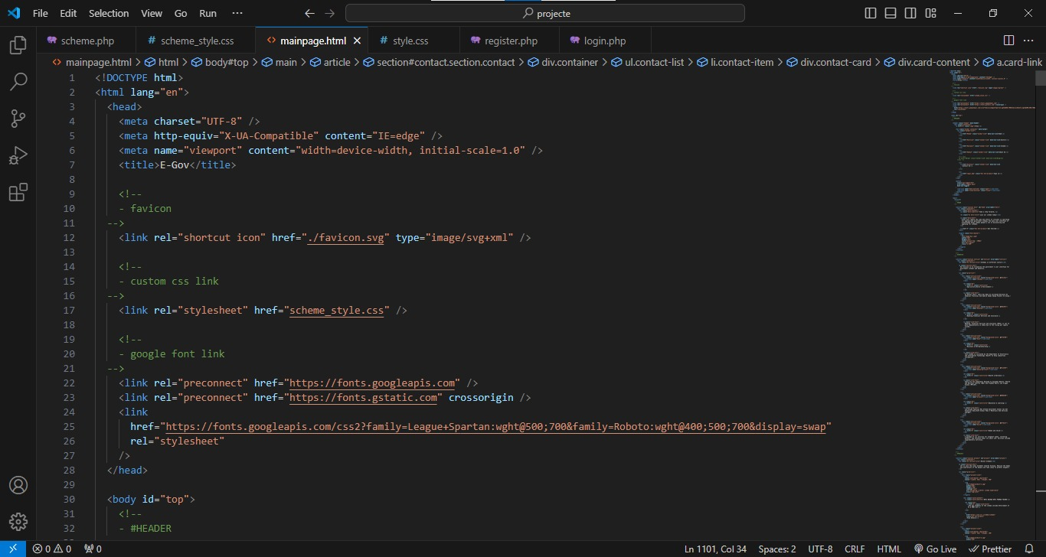
Code
HTML CODE

Slide 22
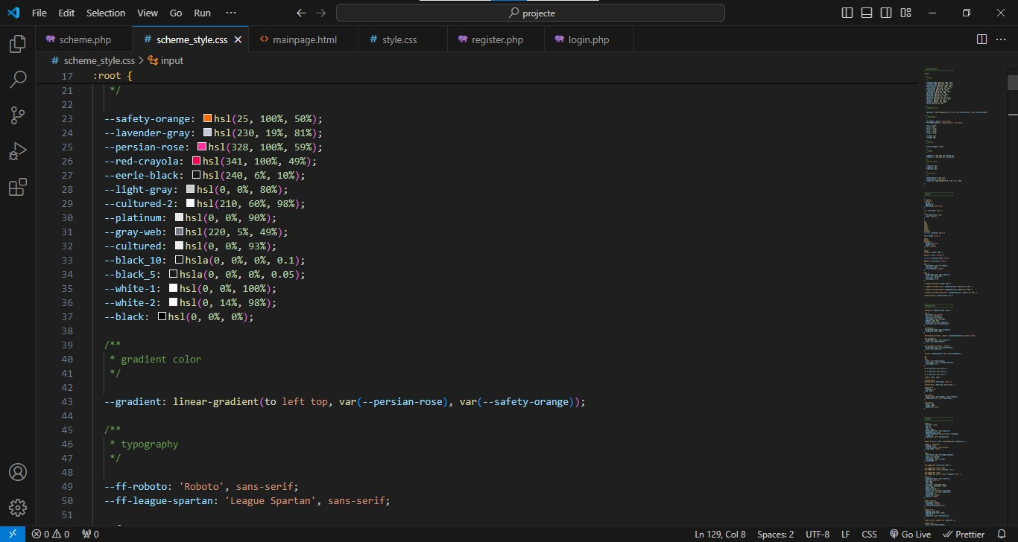
CSS CODE

Slide 23
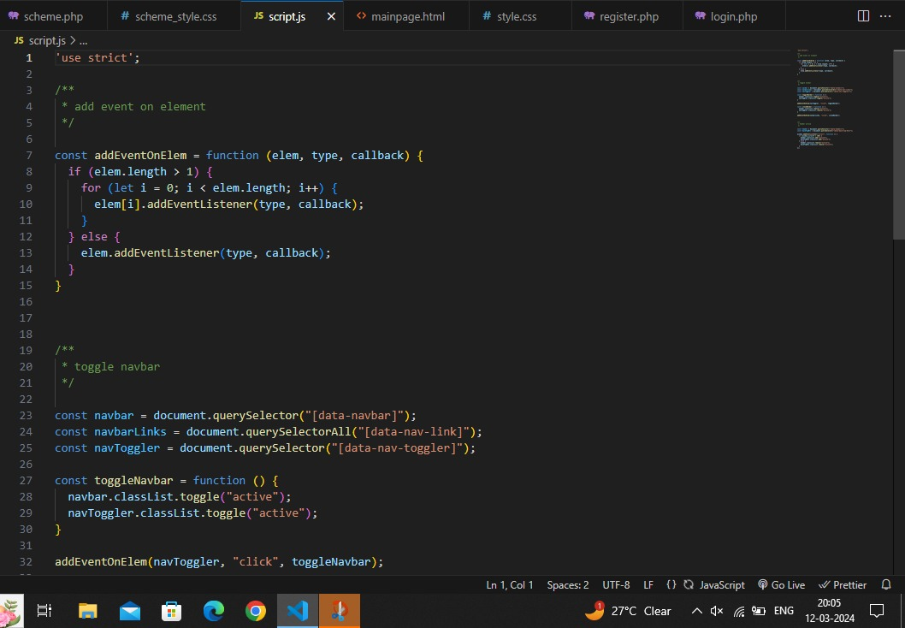
JS CODE

Slide 24
Thank You

